Slide 1
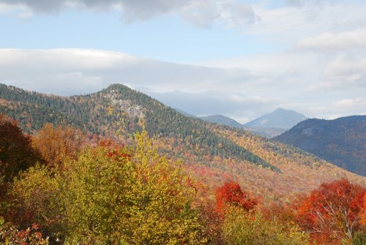
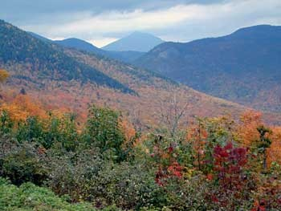
A long-term examination of changing species assemblages in a Northern Hardwood Forest
^{1,2}Jennifer Pontius, ²Joshua Halman and ¹Paul Schaberg
US Forest Service Northern Research Station and UVM Rubenstein School of Environment
Notes:
We were interested to see if climate change has altered forest growth rates or species distributions along elevational gradients.
Long-term forest inventories provide a unique opportunity to quantify changes in forest structure, as well as how changes may deviate from historic models of species succession and biomass accumulation. An examination of a 70-year record on mid-late successional stands at the Bartlett Experimental Forest, NH, USA indicated that species abundances have changed as expected under natural succession, with a few surprises that may indicate changing competitive advantages

Slide 2
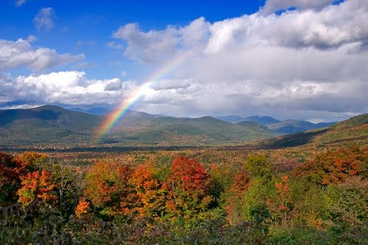
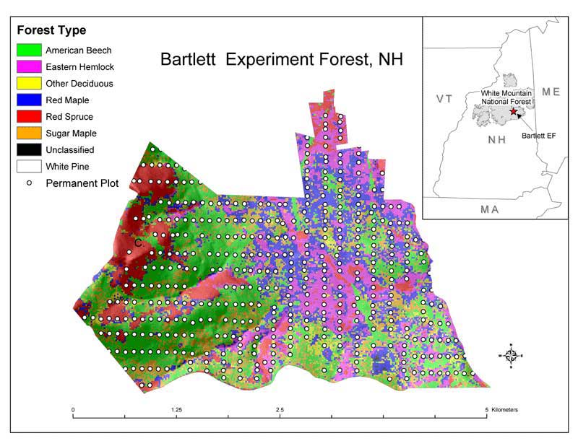
Bartlett Experimental Forest
500 tenth hectare permanent inventory plots
Four complete inventories since establishment (1931,1939, 1991, 2001)
Notes:
The Bartlett Experimental Forest established in 1931, is a 5,789 acre parcel within the White Mountain National Forest, New Hampshire, United States (US) (44°2 ́39 ̋ N, 71°9 ́56 ̋ W). Because of the wide range of topographic and soil characteristics, coupled with climate and species composition representative of the four million hectares of northern hardwood forests found across New England and northern New York (USDA 2008), work conducted at the BEF has been used to inform the silvics and guide forest management decisions across the region for the past five decades (Filip et al. 1960; Leak 1964; Leak and Filip 1977; Leak and Smith 1996; McClure et al. 2000; Solomon et al. 1986).
While species demographics have changed over the 70-year data record as the forest has matured, the most common species have consistently included American beech, sugar maple, yellow birch and eastern hemlock. Red spruce and balsam fir dominate the upper slopes. Elevations range from 210 m in the lower forest to 915 m at the summits. Average monthly temperatures range from approximately -9° C in January to nearly 21° C in July, with ranges from -35° C to over 32° C. Precipitation averages 127 cm per year, with an even distribution throughout the year. About one third comes from snow, accumulating up to 2 m in depth.
Background on Bartlett
The research forest was established in 1931 as a field laboratory to conduct silvicultural research in an area that is very representative of New England forests in general.
33 documented tree species, 77 on file in the database
There are areas of old-growth northern hardwoods with beech, yellow birch, sugar maple, and eastern hemlock being the dominant species. Even-aged stands of red maple, paper birch, and aspen occupy sites that were once cleared. Red spruce stands cover the highest slopes. Eastern white pine is confined to the lowest elevations.
Nearly all of the Bartlett Experimental Forest is now covered by high forest. The primary forest cover type is the sugar maple-beech-yellow birch type. The upper elevations support stands of spruce and fir. Softwoods such as hemlock, balsam fir, and spruce are commonly mixed with hardwoods, especially on cool steep slopes or on the poorly drained soils at lower elevations. Although white pine occurs mostly in stands at lower elevations, scattered specimens can be found over a large part of the Forest. Because of its northeasterly aspect, the Forest does not contain any extensive stands of oak. However, oak types are fairly common nearby on southerly and westerly slopes.
The BEF has 500 0.1 hectare permanent inventory plots distributed across the landscape in a N-S/ E-W grid, spaced at 200 m by 100 m intervals. Since its establishment, four complete forest inventories have been completed: 1931-1932 (henceforth referred to as ‘31), 1939-1940 (referred to as ‘39), 1991-1992 (referred to as ‘91) and 2001-2003 (referred to as ‘01). On each plot, all stems with a diameter at breast height (DBH, 1.4 m above ground level) greater than 4 cm were tallied into 2.54 cm size classes.

Slide 3
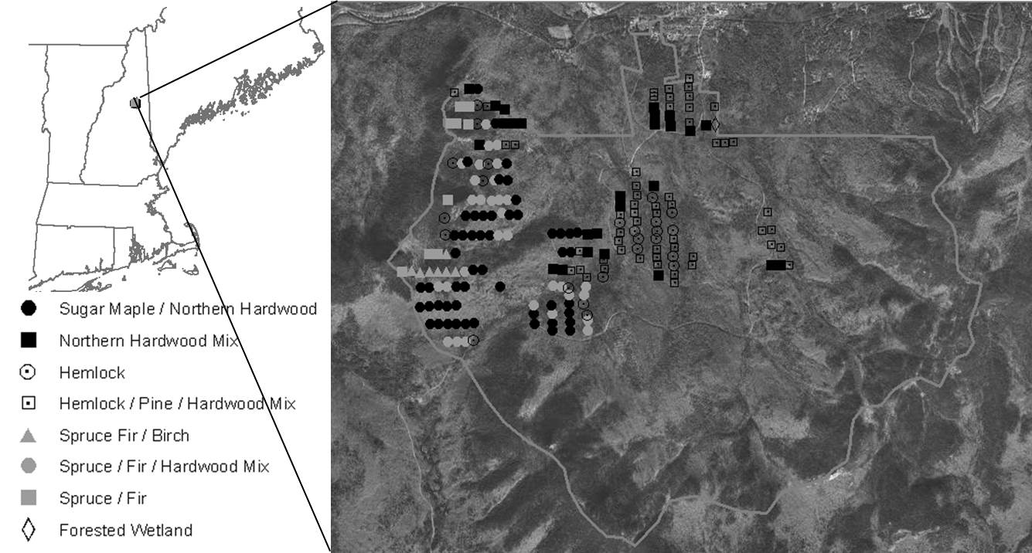
Study Design – minimize influence of disturbance history
A subset of plots (212) were selected with no harvesting activity or evidence of major disturbance since 1900.
During the first inventory, these were mid-late successional stands dominated by beech, sugar and red maple, hemlock , yellow birch and spruce.

Slide 4
The Research Questions
In the absence of major disturbance:
How do changes in species composition match expected successional patterns?
How has the accumulation of above ground biomass changed?
Notes:
By isolating a subset of unmanaged inventory plots with mature forest characteristics and minimal evidence of disturbance, and comparing measurements spanning seventy years, we examine how changes in long-term species composition match expected successional patterns, how these patterns differ along an elevational gradient, and discuss how anthropogenic stressors (e.g., changes in climate and acid deposition) could have influenced observed patterns.

Slide 5
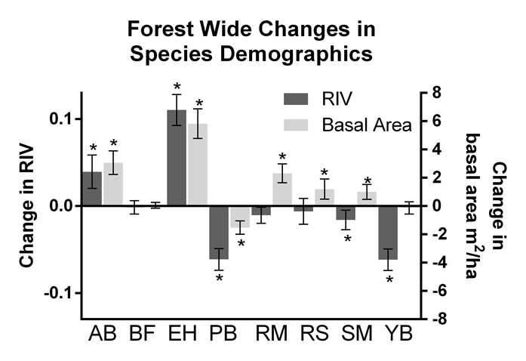
How has species composition changed?
Notes:
Most assessments examine basal area or biomass
We also include RIV
Foster and Reiner (1983), we also calculated species’ relative importance value (RIV) at each plot by summing its relative density and relative basal area values and expressing this sum as a percent of the sum of RIV's for all species at that plot. The resulting response value is a relative measure of species dominance on a given plot on a zero to one scale. While basal area acts as a surrogate for productivity (growth) and could be compared to similar assessments of changing species biomass (van Doorn et al. 2011), the RIV provides a more nuanced assessment of species dominance that results from competition within a plot. Because stand density is included with basal area in the RIV calculation, it represents a more holistic approximation of how growth, recruitment and mortality work together to affect changes in biomass.
This shows that species abundances have changed as expected under natural succession, with significant increases in shade tolerant species such as American beech (Fagus grandifolia ) and eastern hemlock (Tsuga canadensis), and decreases in early successional species such as paper birch (Betula papyrifera).
Sugar Maple:
However, interesting deviations were detected, including significant decreases in sugar maple (Acer saccharum) resulting from reduced regeneration rates over the survey period. This indicates that decreases in sugar maple abundance have occurred relatively recently. Much of this change is driven by the lack of sugar maple regeneration. While basal area has increased, the mean number of stems per plot has decreased significantly between ’39 and the ’99 and ’01 surveys, indicating that any increase in basal area can be almost entirely attributed to continued growth of mature stems (Table 2). A closer examination limited to saplings only found a long-term downward trend in number of sugar maple saplings forest-wide, but with the most dramatic decreases at upper elevations where by 2001 no sugar maple saplings were present on any survey plots (Table 3).
studies from New York and New Hampshire have confirmed that sugar maple reproduction has been greatly impaired due to acidic deposition (Cleavitt et al. 2011, Halman et al. 2013a, Sullivan et al. 2013). Research at HBEF has shown that sugar maple at high elevations are more prone to decline associated with Ca depletion (Minocha et al. 2010). Also at HBEF, experimental Ca additions further suggest that soil acidification and Ca depletion is shifting the competitive balance in the seedling stage toward beech (Marlow and Peart 2014). Other studies have found that the increase in beech sprouts that typically results from BBD further reduces sugar maple seedling survival (Beaudet et al. 1999, Hane 2003). This combination of nutritional stress and elevated competition from increased beech dominance may be responsible for the dramatic reduction in sugar maple regeneration witnessed across the forest. These results add to the growing body of literature that suggests the lack of sugar maple regeneration is a regional concern.
Asterisks indicate a significant difference between the 1931 and 2001 surveys (P < 0.05).

Slide 6
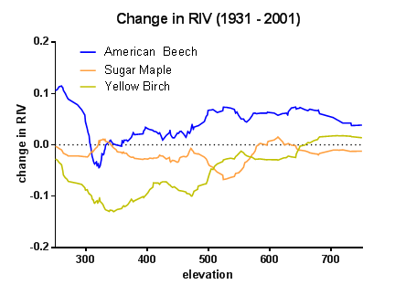
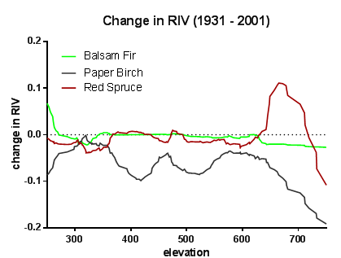
How do changes in species composition differ along an elevational gradient?
Notes:
Smoothed curves of the change (1931-2001) in RIV and basal area across an elevational gradient show significant increases in red spruce at upper elevations at the expense of sympatric balsam fir (Abies balsamea) and hardwoods at upper elevations.
indicating that red spruce may be outcompeting its traditional sympatric counterpart.
Beech is an interesting case:
with the largest short-term gain in basal area at over 1 m² ha⁻¹ yr⁻¹(Table 2), is somewhat unexpected considering the long history of beech bark disease complex (BBD) and decreased beech biomass reported in other studies (van Doorn et al. 2011). We found increased basal area, DBH, and stem counts for beech in both long-term (‘31-‘01) and short-term (‘91-‘01) records
After the first wave of BBD, it is possible that more resistant individuals remained to repopulate the forest. Other instances of resistance have been documented in aftermath forests (Houston 2004).
Perhaps most plausible is that changing environmental conditions have indirectly benefitted American beech by suppressing its important competitor - sugar maple. Across the region, declines of sugar maple have been primarily attributed to acid deposition-induced cation imbalances (Horsley et al. 2002), especially calcium (Ca) depletion (Halman et al. 2013).
Yellow birch:
Declines in yellow birch RIV over the long-term were present forest-wide, but were most pronounced at lower elevations (Fig. 5). We posit that these changes are likely due to the increases in American beech and eastern hemlock over the same elevations. A reduction in yellow birch RIV was likely also influenced by the lack of regeneration for the species (Table 3). Yellow birch requires some degree of soil disturbance to effectively regenerate (Burns and Honkala 1990), and the lack of major disturbance at low- and mid-elevations may have reduced the species’ recruitment ability
Red Spruce:
the sharp increase in red spruce RIV between approximately 600 and 700 m could represent an alternate trend – a resurgence in red spruce productivity. New evidence suggests that red spruce has recently experienced significant increases in radial growth across the region (Kosiba et al. 2013). An increase in red spruce biomass was also detected in recent inventory data from HBEF (van Doorn et al. 2011).
Since the enactment of the 1970 clean air act, rates of nitrate and sulfate deposition have decreased dramatically across the region, which could instigate a rebound in the health and productivity of sensitive species like red spruce within impacted forests. Furthermore, the milder winter temperatures noted in recent years (e.g., Groffman et al. 2012) has likely reduced an inciting factor for red spruce decline – foliar freezing injury. It is also possible that a warming climate has begun to offer red spruce a competitive advantage over its high elevation counterpart balsam fir. Red spruce has the ability to become photosynthetically active and gain carbon under favorable conditions in winter – a trait not present in sympatric balsam fir (Schaberg et al. 1998)

Slide 7
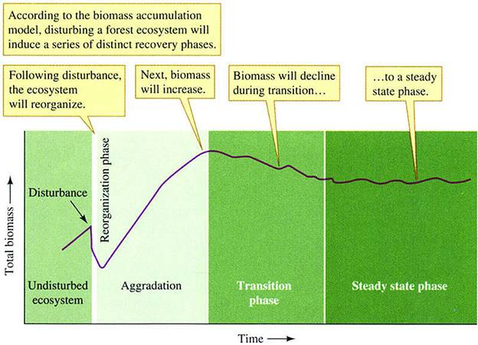
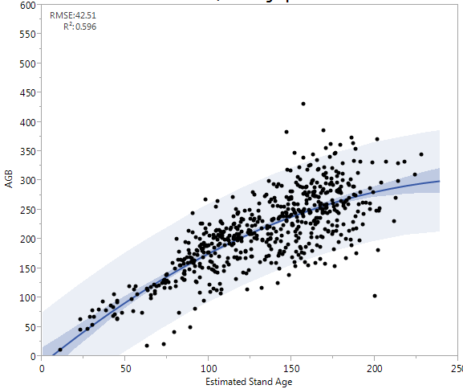
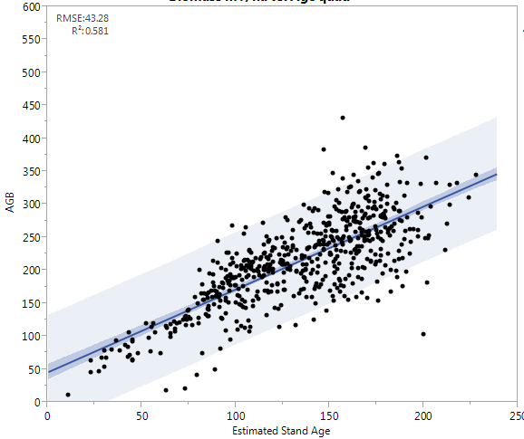
How has above ground biomass at the BEF changed?
Monad Function
Linear Fit
W
W
L
http://sky.scnu.edu.cn/life/class/ecology/chapter/Chapter20.htm

Slide 8
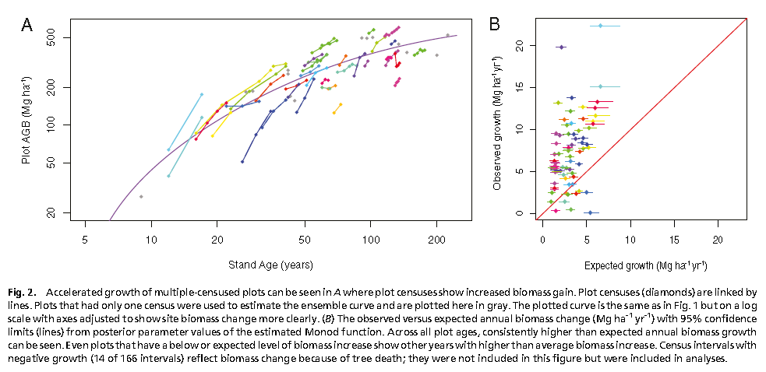
How has the rate of biomass accumulation changed?
There is mounting evidence that biomass accumulation may be accelerating where nutrients and water are not limiting.
McMahon et al. PNAS 2010
Notes:
There is mounting evidence that biomass accumulation may be accelerating where nutrients and water are not limiting.
Data support forest productivity increases across temperate North America, Northern Europe, most of Central Europe, some parts of Southern Europe, and Japan (Boisvenue and Running 2006). Regional studies in North America reported increases in net primary productivity of 2–8% between 1982 and 1998 (Hicke et al. 2002), primarily attributed to increased precipitation and air temperatures that regulate growth-season dynamics (Myneni et al. 1997).
In this example: 55 plots in a tulip and yellow poplar forests in Maryland
Stand age estimated from tree core measurements and land use history
78% of their sites had annual growth estimates exceeding the higher confidence bound of the estimated rate.

Slide 9
How has the rate of biomass accumulation changed?
Increasing AGB accumulation could be linked to:
Increased temperature over the growing season
Longer growing season
Increased CO2 levels
Nutrient fertilization
Community composition shifting to pioneer species
Demographic stochasticity (small scale disturbance)
Incorrect forest growth models
Notes:
Numerous reports have suggested increased growth can be attributed to
recent increases in air temperature (Salzer et al. 2009),
atmospheric CO₂ (Peters et al. 2013),
or a combination of the two without (McMahon et al. 2010) or with the
assistance of a nitrogen (N) fertilizer effect from pollutant N deposition (Zhang et al. 2012
We can rule out community composition and small scale disturbance based on the inventories
It could just be incorrect assumptions about growth of mature stands. Recent evidence suggests that more mature forests may capture and store more carbon than current models suggest (Gunn et al. 2014). Stephenson et al. (2014) demonstrated that at the tree level, mass growth rate increases continuously with tree size for most species, with larger trees actively fixing a larger amount of carbon than smaller trees. They concluded that increases in a tree’s total leaf area outpace declines in productivity per unit leaf area and age-related reductions in population density. This could explain the continued biomass increase on mid-late successional stands at the BEF, where the mean tree size ranges between 17 and 22 cm DBH for the dominant species included in this study, with individuals up to 90 cm on some plots. At the BEF, the shift to these larger tree sizes was particularly evident in sugar maple, red maple, paper birch and yellow birch, where more than 40 percent of all stems were larger than 20 cm DBH by the 2001 inventory.

Slide 10
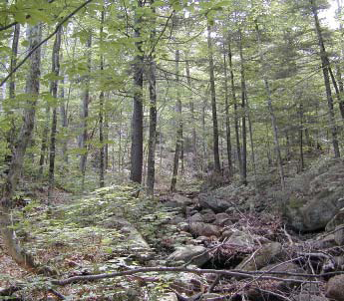
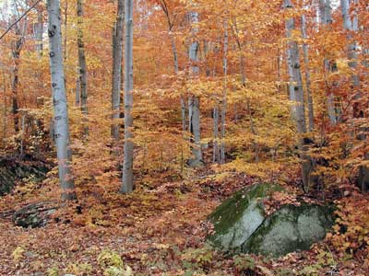
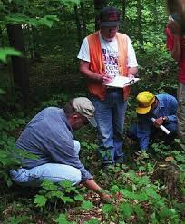
Take Home Message
Rates of AGB accumulation may have increased in recent decades in undisturbed forests.
Most changes in species composition match expected successional patterns.
Major deviations include:
Decreases in sugar maple
Resurgence of red spruce at upper elevations
Loss of yellow birch at lower elevations
Notes:
We conclude that while natural succession continues to dominate changes in species demographics, the influence of changing climate and the legacy of acid deposition may be altering competitive dynamics, favoring species like red spruce and American beech over their common counterparts in northeastern forests.
While sufficient ancillary data, and the residual impact of land use history still evident in BEF’s maturing forests make it impossible to directly link this increase in biomass accumulation rate to anthropogenic drivers, it is possible that numerous recent anthropogenic factors (e.g., changes in climate, atmospheric CO₂, and pollutant inputs) could alone or in combination be altering forest productivity.
The Bartlett Experimental Forest continues to aggrade biomass 70 years after monitoring began, with highest rates in recent decades. Species demographics in the forest have shifted to include eastern hemlock and American beech as dominant species at lower elevations while paper birch has declined throughout the forest. At upper elevations, red spruce has become the dominant species over balsam fir and paper birch, despite decades of acid deposition-associated spruce decline. It appears that the combination of recent reduced acid deposition-loads and warming winters have positioned red spruce at a competitive advantage over sympatric species. Although mature sugar maple and yellow birch are not in apparent decline at BEF, they have experienced long-term decreases in regeneration, while American beech has dramatically increased in number of saplings. Acidified soils have likely hindered the ability of the former species to reproduce while enabling more acid-tolerant, sprout prolific American beech to thrive.

Slide 11
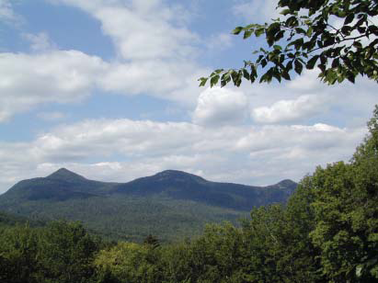
Many Thanks to:
The slew of foresters who toiled up and down the haystacks over the past 85 years collecting this data.
William Leak for his feedback on the manuscript.
Marie Louise Smith for passing down this gold mine of data.
Mary Martin for database and QAQC scripting
Our funding sources:

